Slide 1
Autonomous driving simulation open AI gym (Prakhar M. , Pranav G. , Monalisa N.)

Slide 2
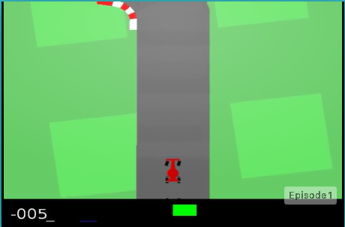
About Open AI CarRacing-v0 :
1.Open AI Car Racing environment provides
a ecosystem to control and drive car
in a simulated environment.
2. Episodes
3. Rewards
Problem Statement:
Create a driving agent which has the capabilities to
interact with open gym AI environment and take
decision for various controls for driving the car based on the current and
past state and maximize the reward.
Ideas : Extract features from the current frame and decide what action should be done based on current state of environment

Slide 3
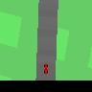
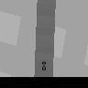
Data Preprocessing :
1- Sample size : 96 x 96
2- Image type : PNG , JPEG , Gray scale.
3- Later png samples were discarded because of extra channel information.
4- State object array was captured in order to generate samples out the environment.
5- Samples were generated only when action is triggered from the player’s side.
Data Statistics :
Training : 12000 images
Validation : 5000 images
Testing images : 1500 images

Slide 4
Implemented Ideas :
Core Idea : Generate 3 control values for car :- [ Steering rotation , Acceleration , Brake value]
CNN model to process current state frame and generate 3 control values.
CNN model to take decision based on concatenation of past 3 images.
CNN model to process using L1 loss and custom learning rate.
CNN model to take decision based on Grey Scale images also appended
CNN + RNN model to taken decision by considering temporal dependency between 2 frames.
MLP Mixer Model with temporal dependency and non temporal dependency

Slide 5
General Architecture of Model:
CNN Model :
n = no of input images concatenated
RNN :
Input 96 * 96 *3n
Conv2D
Max polling 47*47*16
Conv2D
Max polling 22*22*32
Dense output 256
Vector of size 3
Dense output 256
RNN Layer
32 units
Vector of size 3

Slide 6
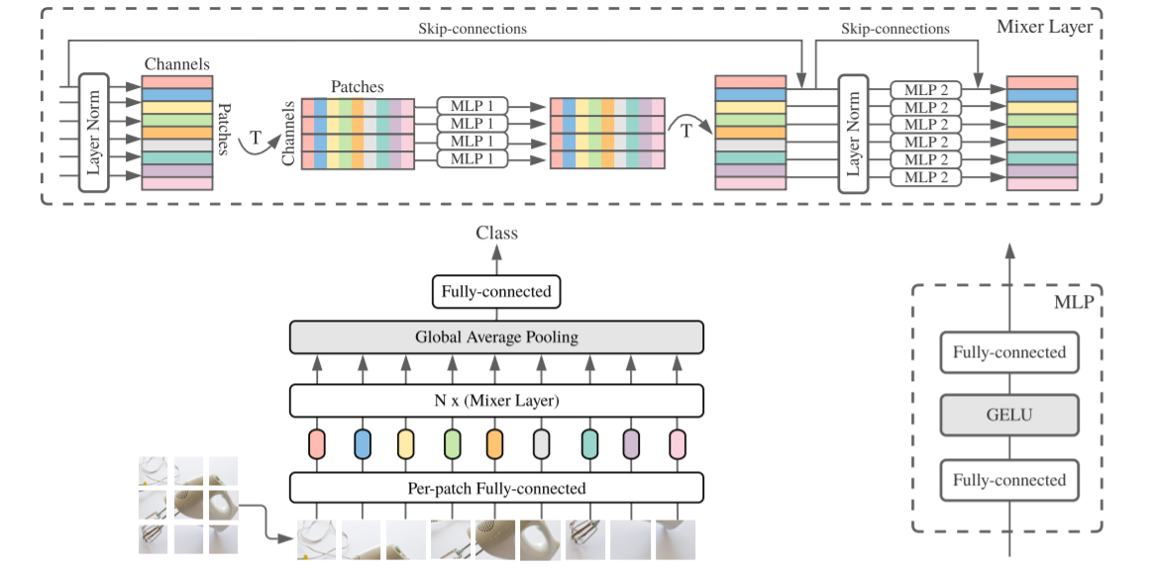
MLP Mixer

Slide 7
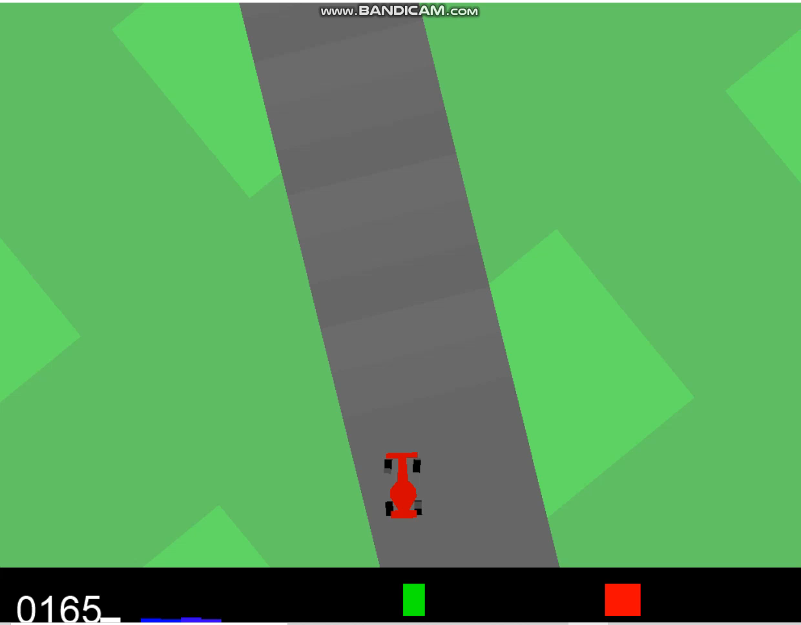
Results 1- Car was able to achieve approximately 800-900 score in general.
2- Best model was CNN with 2 images appended.
3- Average error was still not very low( may be due to regression)
Models | Approx Scores
CNN | ~500
CNN with 3 RGB Images Contenated | ~750
CNN grayscale concatenation | ~890
CNN with RNN | ~790
MLP Multiplexer | ~750

Slide 8
Conclusions
1- Agent was error prone when lot of images of past are used for taking decision.
2- optimal performance was attained when max 3 images was considered from the past
3- Agent was highly underperforming when LSTM were used for considering temporal
dependencies.
4- Simple architecture like MLP Mixer was able to provide significant competitive results as well.
5- Additional Acceleration dataset proved to be booster for agent performance.
Open Points :
1- Reinforcement Learning approach can address this problem?
2- how can model be trained for less oscillations on turns?
3- Can transformers give a more accurate behavioral agent?

